Slide 1




Curriculum for Life Session 5

Slide 2


Curriculum for Life Session 5
Session 5
Key tips on managing debt,
Help and support available
Session 1
What is debt?
Money management – true or false?
Session 2
Video – hear from other 16-25
year olds, Managing your money
Session 3
Why your credit score is so important
Session 4
Different types of debt,
Annual Percentage Rate (APR)
Notes:
Explain what the money management module is expected to help with.
Highlight that this is one lesson out of five and briefly what the other lessons include.

Slide 3


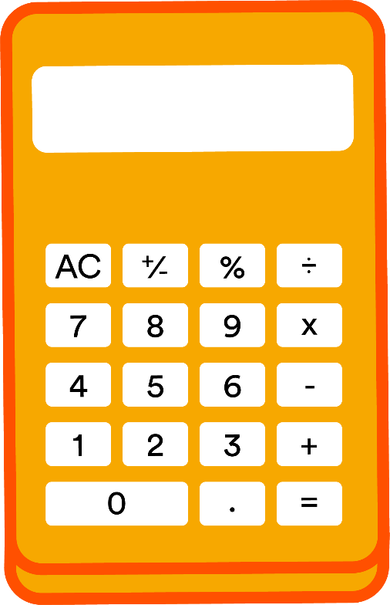

Create a list of how you can manage your finances…
Split this out into two categories
1 - How to prevent yourself getting into debt
2 - What to do if you are in debt
Notes:
Split the group in two and give each group one of the categories. Ask them to write down as many ideas as then can in relation to their category.
After the group have populated some ideas, swap the mind maps over and get them to repeat but with the other category.
Bring the groups back together and get one person from each group to read out their ideas.

Slide 4

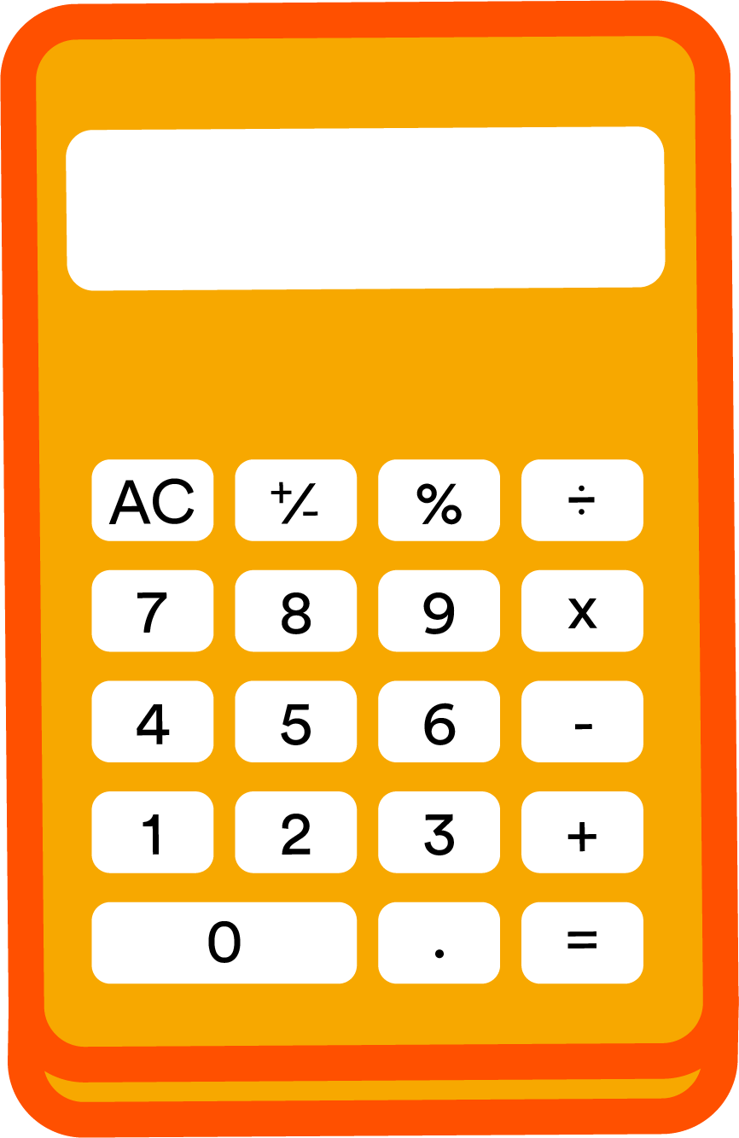
How to prevent
getting into debt
Create a budget for yourself and stick to it
Don’t spend more than you have coming in
Set up direct debits or standing orders for your payments
Check if you can reduce your outgoings
Try and save some money each month in case
of an unexpected spend
Notes:
Run through the points on the slide and link back in with any ideas that the group came up with.
Budget – this should ensure you have enough money left to pay for the important things.
Make sure that you only spend what you can afford.
Direct debits or standing orders – this will ensure your payments are made on time
Reduce outgoings – you may be able to reduce what you are paying out such as household bills or council tax.
This will help to give you back up in case of an unplanned spend

Slide 5
What to do if
you are in debt
Have a plan to pay off your debts
– use the help and support available
Don’t hide the debt from yourself or others
Work out how much you can afford to regularly pay
Speak to the companies that you have the debt with
- a lot of free support is available
Notes:
Run through the points on the slide and link back in with any ideas that the group came up with.
Plan – if you work through a plan it will help to structure how you will pay the money back.
Don’t hide – accepting the debt is the first step towards getting it sorted.
Afford to pay back – find an amount that you will be able to keep paying otherwise you may end up in further debt.
Speak to companies – they will often be able to help and some will have some form of debt repayment plan. Move onto the next slide which details some of the organisations that provide free help and advice.

Slide 6





Citizens Advice
https://www.citizensadvice.org.uk/
Money Advice Service
https://www.moneyadviceservice.org.uk/en
Money Saving Expert
https://www.moneysavingexpert.com/
Notes:
Talk through the help and support available and you can direct them to these sites for further information.

Slide 7


We’re here when you need us
Don’t ignore the problem
Talk to companies that you owe money to
Priority Services – for you or a family member
For information about the help and support available at United Utilities, please see our website: https://www.unitedutilities.com/
Notes:
The important thing to remember if you’re finding it hard to pay your bills is - don’t ignore the problem. Debts very rarely disappear all by themselves!
If you’re ever struggling to pay your water bill, the good news is that we have lots of ways we can help. This could include delaying your payments, reducing your bill or setting up a payment plan which makes your bill easier to pay. Paying your water bill by Direct Debit will also reduce your bill by £5 a year.
Remember, most companies you deal with will help if you’re struggling with your bills so always give them a call as soon as you have a problem. Companies have nothing to gain by you falling behind with your payments and will always try to help.
If you or a family member need additional support due to disability, mental health issues, debt or age, please let us know. We can then register you for our Priority Services scheme which means you benefit from additional free services related to your water and wastewater services. Your energy company will also have a priority services scheme you can register for.

Slide 8


Notes:
Briefly discuss what has been run through in the session and answer any questions with the group to ensure they have understood the content.
Ask each of the participants for one thing that they have learnt today.

