Slide 1
Supplier Case Studies
Our Supplier Collaboration in action

Slide 2


Case study 1
Rainwater storage for Lancashire Farms supplying Food Banks

Slide 3
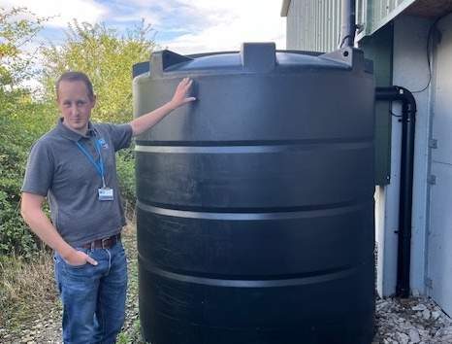
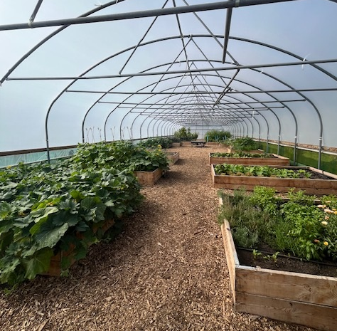
Overview
Rainwater Storage
This project is important to United Utilities as it is part of the ongoing process to reduce rainwater inundating our sewer networks in an area that has been severely affected in recent years. The farm specifically was selected due to their donations to foodbanks in the local community.
Thousands of litres of rainwater storage have been installed at Blackburns Farm in Wrea Green, Lancashire, through our contacts at Lancashire County Council. This was a follow-up to a smart water butt trial funded by United Utilities that began in the village in 2023.
Three 5,000 litre smart water tanks are now set to collect rainwater from large roof surfaces around the farm and will help irrigate fruit and vegetables grown on-site that will then be passed on to local food banks.
These huge water tanks store rainwater supporting these reductions and water captured in the farm's tanks will be released into the polytunnel ahead of downpours.
As of May 2025, the tanks have captured around 63,000 Litres of rainwater with more than 61,000 Litres being reused.

Slide 4
Outcome
Rainwater Storage
Charity giving
Prior to the installation, the farm was able to provide support to foodbanks for 26 weeks a year, providing fresh produce throughout the growing season.
With the new system, Blackburns farm will now be able to expand their efforts by also growing vegetables during the colder months, so they can supply the food banks all year round.
Community Impact
This expansion will open up more opportunities for volunteers and educational groups to get involved, making an even bigger impact on both the farm and our community.
Positive Environmental Impact
The tanks have resulted in a reduction of sewerage inundation within the area of the farm as the water is now captured by the rainwater tanks.
This piece of work demonstrates our Water Consumption Responsible Sourcing Principle and showcases how by collaborating with our supply chain we can have a positive impact on our environment if we start to think about what we are using and how.

Slide 5


Case Study 2
Visibility of Labour Agency operations

Slide 6
Overview
Labour Agency Operations
United Utilities have been a member of Slave-Free Alliance (SFA) since June 2022.
In February 2023, SFA delivered a gap analysis identifying that United Utilities lacked visibility of its labour agencies’ operations, relying too heavily on the expectation that they conducted their own due diligence.
SFA advised to conduct a risk assessment on Reed and help them develop a framework allowing for greater visibility, continuous collaboration and monitoring.
The virtual assessment included workforce information, risks and best practices to address modern slavery.
United Utilities have made plans to use this as a process guide for any future assessments of Reed or other labour providers.
The assessment seeks to evaluate the effectiveness of:
Training & Awareness
Response to Modern Slavery & Labour Exploitation
Grievance Mechanisms
Recruitment & Employee Management
Policies & Procedures
Address risks of Modern Slavery & Labour Exploitation

Slide 7
Outcome
Labour Agency Operations
Enhanced Due Diligence
The risk assessment that was used to conduct due diligence on Reed can now be used as a baseline to conduct further due diligence with other suppliers.
Improvement to Procurement Processes
Amends have been made to the United Utilities PQQ (pre-qualification questionnaire) and ITT (Invitation To Tender) questions which will greatly increase the visibility of subcontracted labour providers and payroll companies, both of which are key modern slavery risks in the temporary recruitment sector.
This piece of work demonstrates our commitment to our Human Rights and Fair Treatment Principle to promote equal opportunities to all our employees, customers and suppliers. Transparency within our supply chain can also help mitigate third party risks and work together to deliver better outcomes for our customers, our colleagues and our communities.

Slide 8

Case Study 3
Huntington WTW Innovation Project

Slide 9
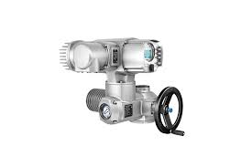
Huntington WTW Innovation Project
Overview
A Start Up to Waste notice had been issued by the Drinking Water Inspectorate (DWI) along with Regulatory dates.
This required an upgrade to first stage filter (GAC) streams 1, 2, and 3, and the works needed to be completed by 31st December 2024.
Failure to comply with Regulations would involve prosecution. United Utilities looked out to its supply chain for innovative ideas for how to ensure the work was completed in a timely manner.
United Utilities worked with Auma, who were able to install a “SAV Variable speed actuator”, which allowed for variable speed control of the valve across 10 different sectors of travel, giving precise positioning and feedback.
AUMA were able to collaborate with United Utilities Instrumentation Field Service Engineers, Production managers, Projects managers, and FSEs.
Emergency shut function was programmed in at the United Utilities specified desired speed.
Variable speed actuators work well together with UPS and Battery Back-up systems due to low energy usage, and the fact that they can be programmed cascade startup, preventing large energy surges.

Slide 10
Outcome
Huntington WTW Innovation Project
Regulatory Impact
We were able to complete the project on the 20th December ahead of the DWI deadline which meant we were not prosecuted.
Cost Effective
Auma enabled the project to be delivered under budget which satisfied DWI regulation. Overall a huge success!
Collaboration
Auma were great at helping us achieve our target and working collaboratively to get actuators on-site as early as possible to start a phased swap-out with our operational teams. This collaborative work is something we are looking proactively to implement across both our water and wastewater sites.
The responsiveness of our supplier to meet our regulatory deadlines demonstrates their commitment to our Responsible Sourcing Principle of Business Ethics and Governance, upholding our high requirement standards to ensure regulatory adherence in a cost-effective manner.

Slide 11

Case Study 4
Network Plus Sustainability Project

Slide 12
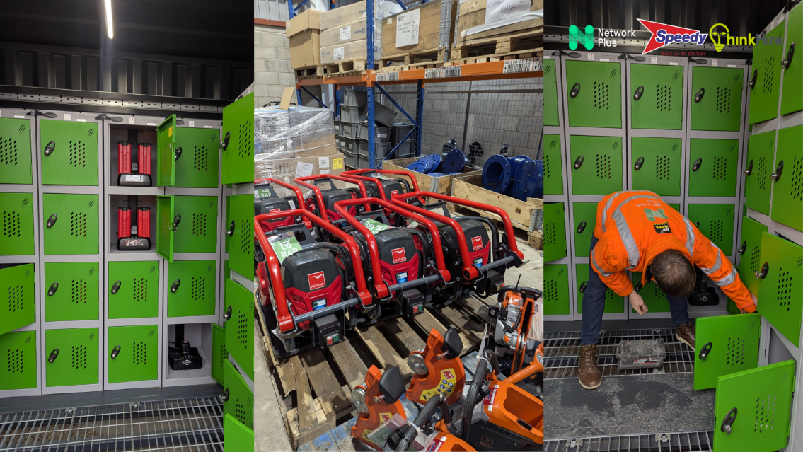
Network Plus Sustainability Project
Overview
Network Plus have partnered with Speedy Hire and Sunbelt Rentals, both of whom are suppliers to United Utilities to replace some of their petrol-driven equipment with electric models at their Bristol and United Utilities sites.
The batteries for the equipment will then be charged using solar charging stations. This shows how suppliers are working together across United Utilities sites to drive towards sustainability commitments.
Network Plus released a series of battery-charged equipment across the business which are charged using solar battery charges.
For United Utilities this was:
1 Battery Foot Rammer
13 Battery Disk Cutters
11 Battery Breakers
7 Battery Vibrating Plates
1 solar battery charger

Slide 13
Outcome
Network Plus Sustainability Project
Environmental
The switch to battery-powered equipment and solar charging saw a reduction in environmental impact.
Ways of Working
The new equipment also offers a safer way of working as it is lighter, with reduced lower hand/arm vibration, and removes the noise and CO2 fumes of petrol-driven models.
Cost Efficiency
The decrease in damaged or failed equipment and reduction in fuel costs is expected to save the business up to 30% in whole life costs.
As a signatory to United Supply Chain, Network Plus has demonstrated a clear commitment to our Environment and Pollution Responsible Sourcing Principle by reducing the CO2 fumes which pollute the air. They have also demonstrated an awareness for Human Rights and Fair Treatment by reducing lower hand/arm vibration to offer a safer workplace.
Network Plus have gone the extra mile and shown a commitment to driving towards sustainability goals. We look forward to continuing this collaborative working relationship.

Slide 14

Case Study 5
PPE Recycling and Sustainable Disposal

Slide 15
Recycling and Sustainable Disposal of PPE
Overview
In February 2025, United Utilities set out to collect and redistribute PPE (Personal Protective Equipment) that wasn’t being used by employees. Collections were separated based on whether they could be reused or required disposal.
A total of 887 items were collected, 90% of which were recycled sustainably through collaboration with JK Ross. The rest were washed and will be stored in the new PPE store.
Next Steps
A PPE store is being developed in the United Utilities Security Hut at Lingley Mere in Warrington, which will allow employees to borrow PPE when needed instead of ordering kit which may see limited use.

Slide 16
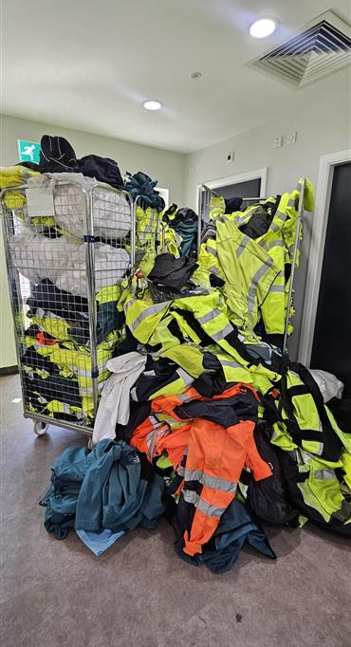
Outcome
Recycling and Sustainable Disposal of PPE
Circular Economy and Environmental Impact
The collection of unused PPE helps demonstrate circular economy, ensuring it is used at its highest value and material can be recycled where possible.
The collaboration with JK Ross has allowed for material which couldn’t be reused to be disposed of sustainably, helping to reduce pollution.
An additional outcome is the removal of out-of-date and potentially unsafe PPE that people may possess, with the store also providing easy access to PPE; ensuring employees have the PPE they require to remain safe on the various United Utilities sites.
Future Improvement
The implementation of the PPE store also helps to design out waste in the future by offering employees the option to use the existing PPE instead of placing new orders.
This demonstrates United Utilities’ and our supplier’s commitment to uphold our Responsible Sourcing Principles through Circular Economy to design out waste.

Slide 17
Case Study 6
Donation of unwanted furniture

Slide 18
Overview
Donation of unwanted furniture
United Utilities’ Commercial department was carrying out a Cost reduction exercise with the Property team to look at ways of reducing our furniture in lock-ups that we currently hold.
Through this exercise, we identified numerous items of furniture that were no longer needed within the business, so explored opportunities to locally donate them for better use.
A retired United Utilities colleague reached out to the Commercial department to determine if any spare furniture was no longer needed, and whether the church he was part of, Brooklands Church of the Nazarene in South Manchester, could utilise within his church for community purposes.
The church is the only community facility on its council estate and hosts a full programme of Christian activities. It also offers an affordable warm café for people to meet up with friends and neighbours, a food pantry to help locals with the cost of living, free meals every Wednesday tea time, and much more.
Commercial had a conversation with the colleague to understand his specific requirements. We determined that the furniture previously identified would be a great fit, so we proceeded to arrange a collection.

Slide 19
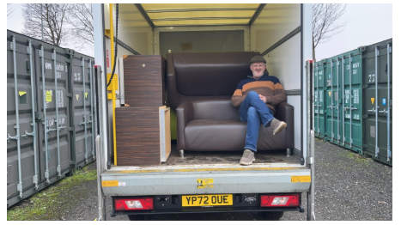
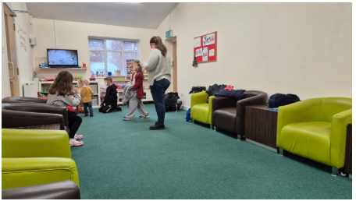
Outcome
Donation of unwanted furniture
Community Impact
The furniture that was not being utilised in United Utilities is now being utilised within the church. The community is now benefitting from this donation and can hold community events and activities within the church.
Sustainability
Commercial will maintain ongoing collaboration with the Property team to manage the disposal of unwanted furniture, ensuring that sustainability remains a key consideration and we can create greater impact within the Community!
This demonstrates United Utilities’ commitment to uphold our Responsible Sourcing Principles internally through Circular Economy to reduce waste and support the local community.

